Slide 1

Status report on the current and future satellite systems by [CGMS agency] Presented to CGMS-51 plenary session, agenda item [xx]

Slide 2
Executive summary
Please include an executive summary of the report here. It will be included in the final report.

Slide 3
Overview - Planning of [CGMS agency] satellite systems
Include a table, graph, timeline, to illustrate current and future satellites
> EUMETSAT and CMA examples on the next two slides

Slide 4
EXAMPLE - Overview - Planning of EUMETSAT satellite systems
YEAR...
00
01
02
03
04
05
06
07
08
09
10
11
12
13
14
15
16
17
18
19
20
21
22
23
24
25
26
27
28
29
30
31
32
33
34
35
36
37
38
39
40
METEOSAT FIRST GENERATION
METEOSAT-6
METEOSAT-7
METEOSAT SECOND GENERATION
METEOSAT-8
METEOSAT-9
METEOSAT-10
METEOSAT-11
Mandatory Programmes
METEOSAT THIRD GENERATION
MTG-l-1
MTG-S-1
MTG-l-2
MTG-l-3
MTG-S-2
EUMETSAT POLAR SYSTEM (EPS)
MTG-l-4
METOP-A
METOP-B
METOP-C
EPS SECOND GENERATION
OCEAN SURFACE TOPOGRAPHY MISSION
JASON-2
JASON-3
Optional and 3rd Party Programmes
JASON CONTINUITY OF SERVICES (CS)
THIRD-PARTY PROGRAMMES
GMES SENTINEL-3
GMES SENTINEL-4 ON MTG-S
GMES SENTINEL-5 ON EPS SECOND GENERATION

Slide 5
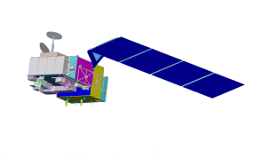



EXAMPLE - Overview - Planning of CMA satellite systems
Road Map of FENGYUN Meteorological Satellites Development by Year 2020
2013FY-3C(Op)
2014FY-2G
2015FY-2H
2012FY-2F
2015FY-4A (R&D)
2010FY-3B (R&D)
2015FY-3D(Op)
2008FY-3A (R&D)
2016FY-RM(R&D)
2017FY-4B (Op)
2017FY-3E(Op)
2019FY-3F(Op)
2020FY-RM2
2020FY-4C(Op)

Slide 6
Coordination Group for Meteorological Satellites - CGMS
Main highlights/issues regarding GEO satellites since the latest CGMS plenary meeting...
.
.
CURRENT GEO SATELLITES

Slide 7
Coordination Group for Meteorological Satellites - CGMS
Main highlights/issues regarding LEO satellites since the latest CGMS plenary meeting...
.
.
CURRENT LEO SATELLITES

Slide 8
Coordination Group for Meteorological Satellites - CGMS
Main highlights/issues regarding HEO [or other] satellites since the latest CGMS plenary meeting...
.
.
CURRENT HEO [or other] SATELLITES

Slide 9
Coordination Group for Meteorological Satellites - CGMS
Main highlights/issues regarding R&D satellites since the latest CGMS plenary meeting...
.
.
CURRENT R&D SATELLITES

Slide 10
Coordination Group for Meteorological Satellites - CGMS
Main highlights/issues regarding GEO satellites since the latest CGMS plenary meeting...
.
.
FUTURE GEO SATELLITES

Slide 11
Coordination Group for Meteorological Satellites - CGMS
Main highlights/issues regarding LEO satellites since the latest CGMS plenary meeting...
.
.
FUTURE LEO SATELLITES

Slide 12
Coordination Group for Meteorological Satellites - CGMS
Main highlights/issues regarding HEO [or other] satellites since the latest CGMS plenary meeting...
.
.
FUTURE HEO [or other] SATELLITES

Slide 13
Coordination Group for Meteorological Satellites - CGMS
Main highlights/issues regarding R&D satellites since the latest CGMS plenary meeting...
.
.
FUTURE R&D SATELLITES

Slide 14
Coordination Group for Meteorological Satellites - CGMS
...
.
.
Key issues of relevance to CGMS:

Slide 15
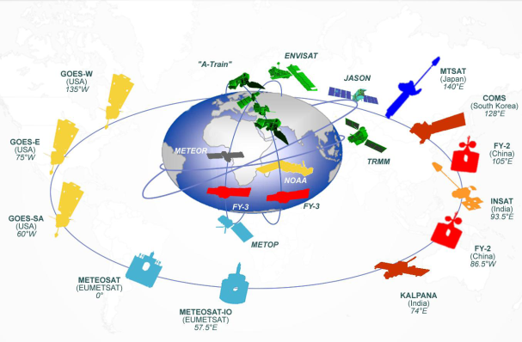
Coordination Group for Meteorological Satellites - CGMS
...
.
.
To be considered by CGMS:

